Slide 1
BidWinner
Safe & Secure Online Auction Site
Yehan Banura Kapurubandara
G20943498

Slide 2

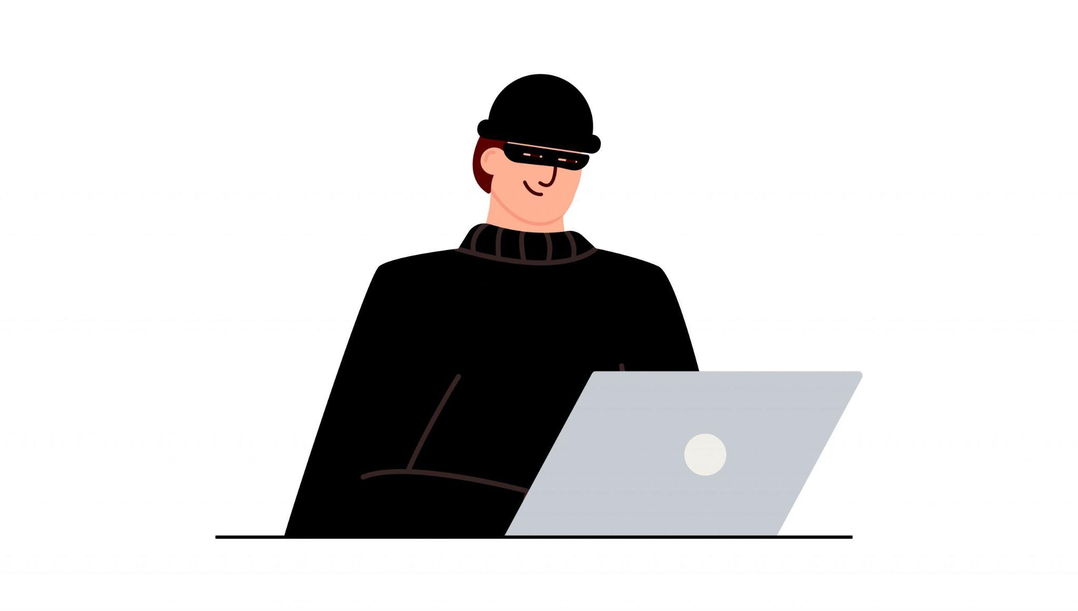
Introduction
Online auction sites have revolutionized the way we buy and sell goods.
Provides a vast marketplace which is accessible to millions of people.
These websites are exploited by scammers

Slide 3
Why are online auction sites popular targets ?
Online auction sites attracts a diverse and large range of buyers and sellers
The online environment provides anonymity for scammers
Auctions can involve high value items

Slide 4
The Impact of online scams
Victims of online scams suffer significant financial loss.
Being deceived can cause emotional stress.
Reputation of some websites are tarnished.

Slide 5
The importance of mitigating online scams
Protecting money of innocent users.
Retaining the trust of online auction sites
Understanding ways to mitigate these scams are good for self empowerment.

Slide 6
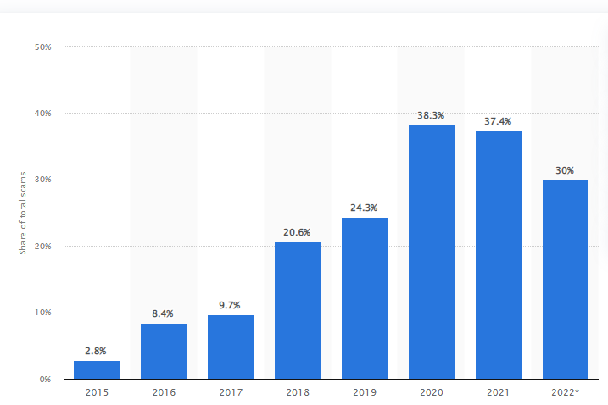
Percentage of online scams among others

Slide 7
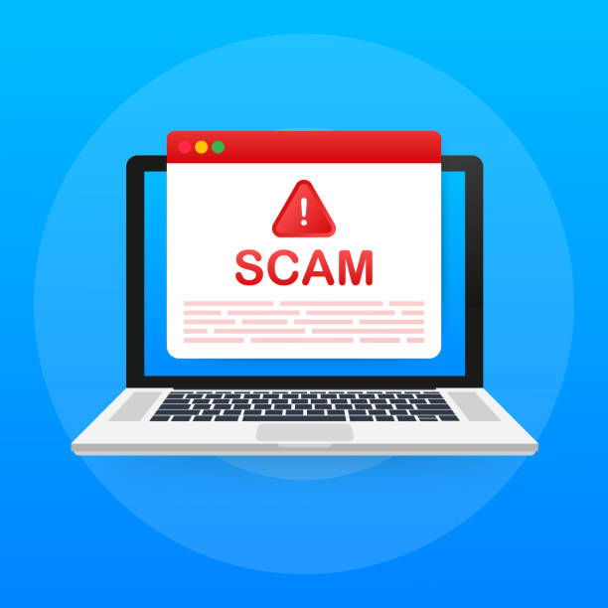
Common Online scams
Non delivery Scams
Seller fails to deliver after purchase has gone through.
Tips to mitigate;
Check sellers feedback and ratings .
Use Secure payment methods that offer buyer protection .
Be cautious of deals that seem too good to be true.

Slide 8
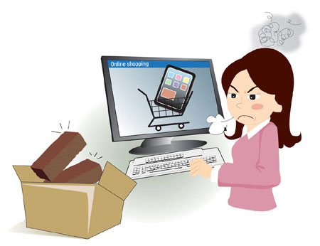
Counterfeit or Misrepresented items
Sellers list fake or misrepresented items to trick buyers into buying a product.
Tips to mitigate;
Examine item descriptions and photos carefully
Research the products details before buying
If possible, request additional information from seller

Slide 9







Technologies used

Slide 10

Conclusion
BidWinner was created with these problems in mind
Let’s get to the demonstration

Slide 11

Thank you Any Questions?

